Slide 1
Web Design with HTML5 & CSS3 8th Edition
Chapter 7
Improving Web Design with New Page Layouts

Slide 2
Chapter Objectives
Explain when to use article, aside, and section elements
Define figure and figcaption elements
Redesign wireframes for tablet and desktop viewports
Explain and use the opacity property
Describe and use the text-shadow property

Slide 3
Chapter Objectives (continued)
Add a banner image to a website
Insert and style a figure element
Insert and style a section element
Insert and style an article element
Insert and style an aside element
Create a three-column layout
Describe and use the overflow property

Slide 4
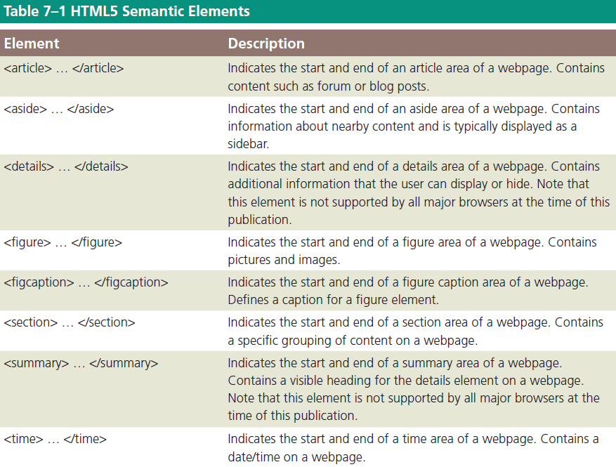
Using HTML5 Semantic Elements

Slide 5
Article Element
The article element, as described by the W3C, is
a complete, self-contained composition in a document, page, application, or site
independently distributable or reusable, e.g. in syndication
The start and end tags of article elements are <article> and </article>
Content placed between these tags will appear on a webpage as part of the article element

Slide 6
Article Element (continued 1)
Articles may be nested within other HTML elements, such as the main element, the section element, or other article elements
Articles are commonly used to contain news articles, blog and forum posts, or comments

Slide 7
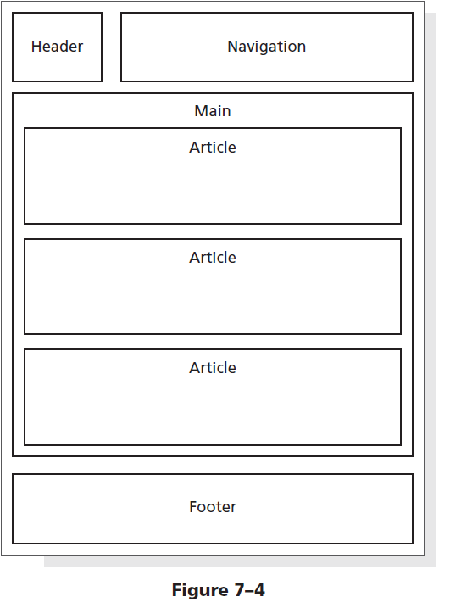
Article Element (continued 2)

Slide 8
Aside Element
The aside element is used as a sidebar that contains additional information about a particular item mentioned within another element
For example, if an article on a webpage contains a recipe and a list of ingredients, one could include an aside element with more information about one of the key ingredients, such as its origin or where to purchase it
It can be nested within article elements or within main or section elements

Slide 9
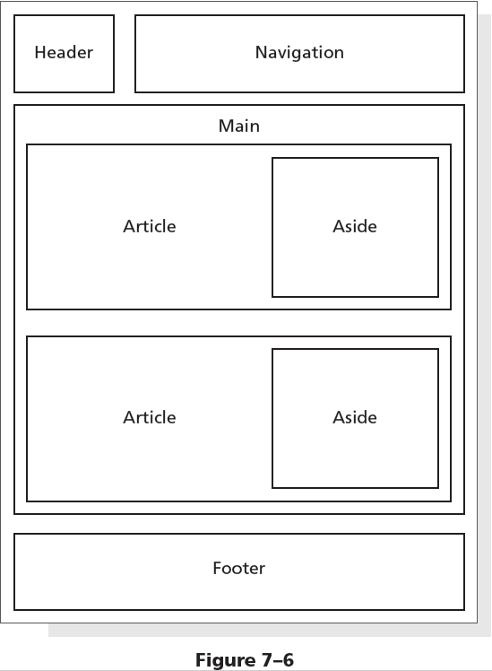
Aside Element (continued)

Slide 10
Section Element
The section element, as described by the W3C, is an element that
represents a generic section of a document or application. Here, a section is a thematic grouping of content. The theme of each section should be identified as a child of the section element
is not a generic container element. A general rule is that the section element is appropriate only if the element’s contents would be listed explicitly in the document’s outline

Slide 11
Section Element (continued 1)
The following is an example of a several section elements nested within an article element
<article>
<h1>Tutorials: Cooking Basics</h1>
<p>Watch our tutorials to learn the basics of good cooking.</p>
<section>
<h1>Tutorial 1</h1>
<p>Assembling basic kitchen tools.</p>
</section>
…
</article>

Slide 12
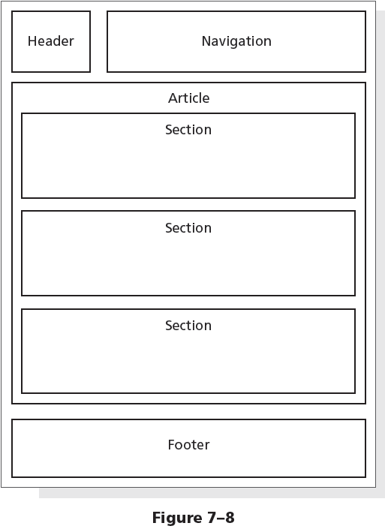
Section Element (continued 2)

Slide 13
Figure and Figure Caption Elements
The figure element is used to group content, such as illustrations, diagrams, and photos
According to the W3C, the figure element represents some flow content that is self-contained and is typically referenced as a single unit from the main flow of the document
A figure element can contain one or more img elements

Slide 14
Figure and Figure Caption Elements (continued 1)
The figure element may contain an optional figure caption element, which is used to provide a caption for the figure element
The start and end tags of the figure caption element are <figcaption> and </figcaption>

Slide 15
Figure and Figure Caption Elements (continued 2)
The following is an example of the figure element and the figure caption element
<figure>
<figcaption>New York City Highlights</figcaption>
<img src="ny1.jpg" alt="Statue of Liberty">
<img src="ny2.jpg" alt="Central Park">
<img src="ny3.jpg" alt="New York at Night">
</figure>

Slide 16
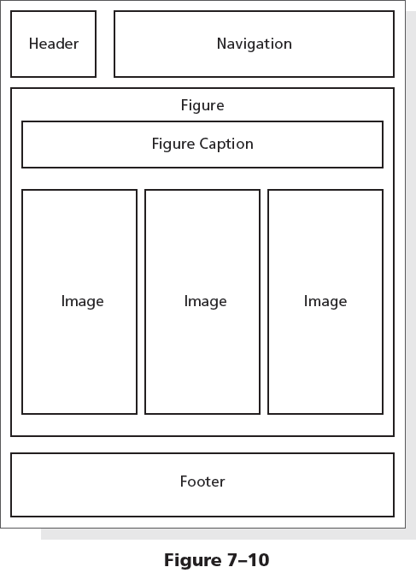
Figure and Figure Caption Elements (continued 3)

Slide 17
Website Layout
A banner is a graphic that spans the width of a webpage and usually brands a website, often by displaying its name or an identifying image
The CSS3 opacity property specifies the transparency of an element
The text-shadow property applies a shadow to text
h-shadow value – designates the horizontal position of the shadow
v-shadow value – designates the vertical position of the shadow

Slide 18
Website Layout (continued)
An example of a style rule that applies a text shadow to an element is shown below
h1 {
text-shadow: 0.2em 0.1em #292933;
}
In this example, a text shadow with a horizontal position of 0.2em, a vertical position of 0.1em, and a dark gray color is applied to an h1 element

Slide 19
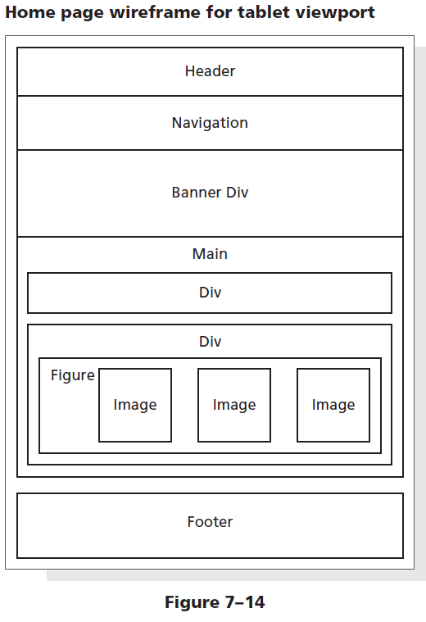
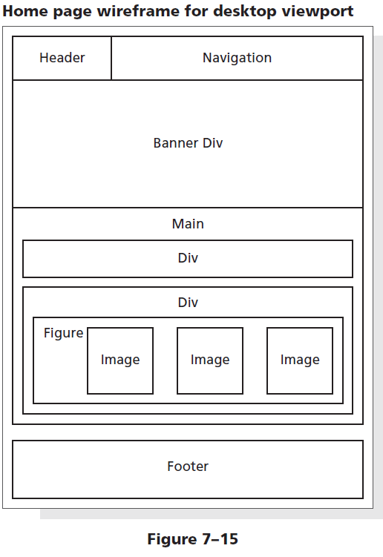
Redesigning the Home Page

Slide 20
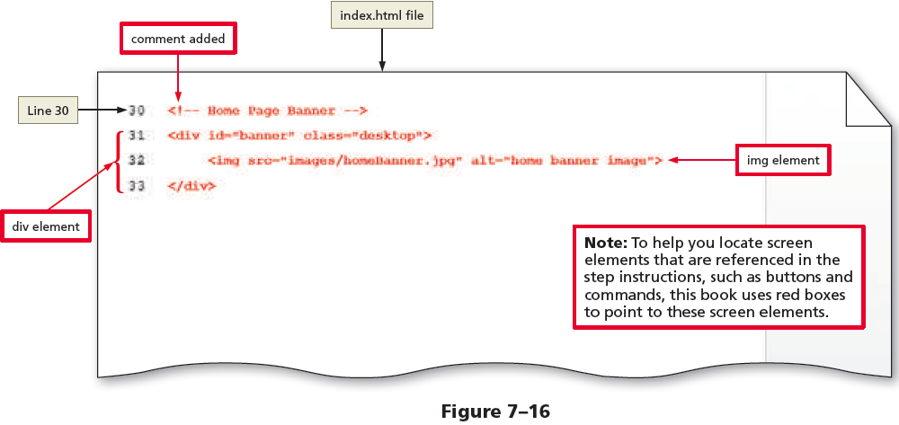
To Add a New div Element to the Home Page

Slide 21
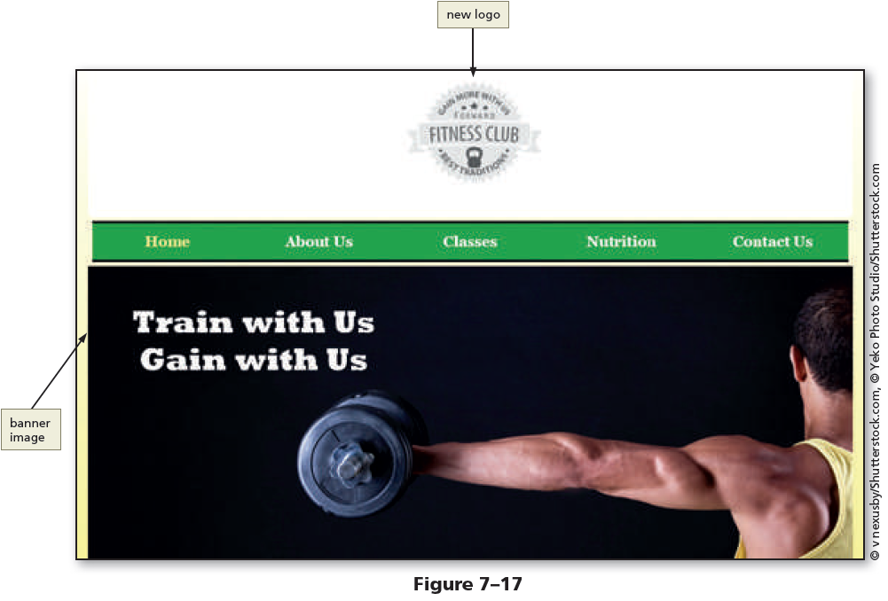
To Add a New div Element to the Home Page (continued)

Slide 22
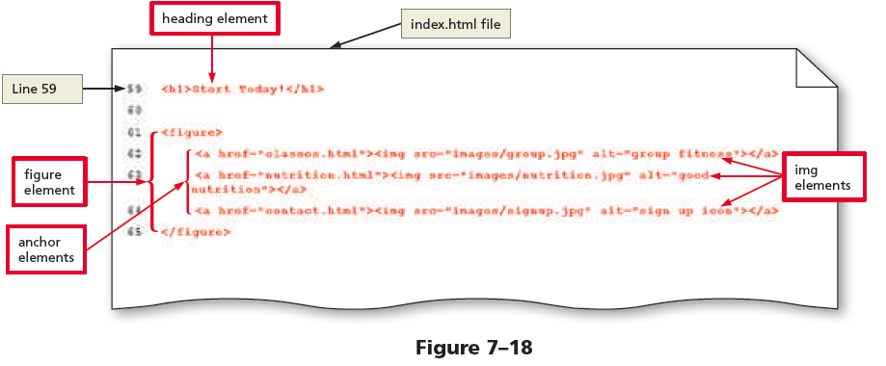
To Add a figure Element to the Home Page

Slide 23
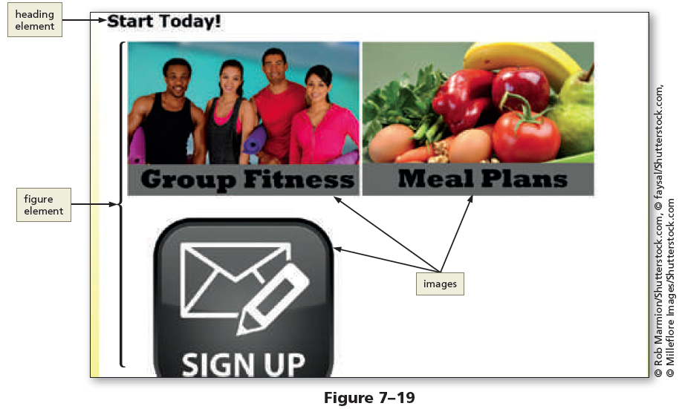
To Add a figure Element to the Home Page (continued)

Slide 24
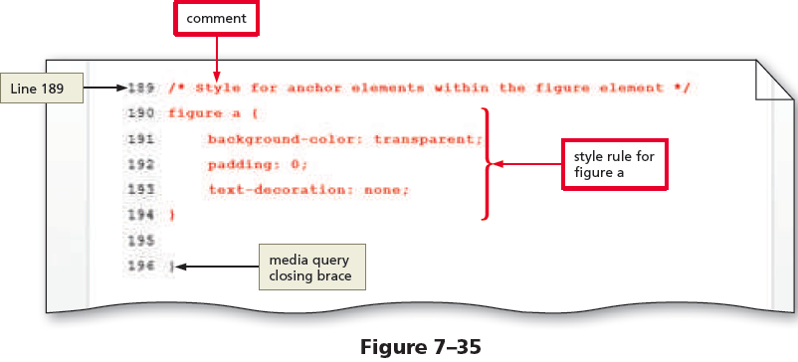
To Add New Style Rules to the Tablet Viewport

Slide 25
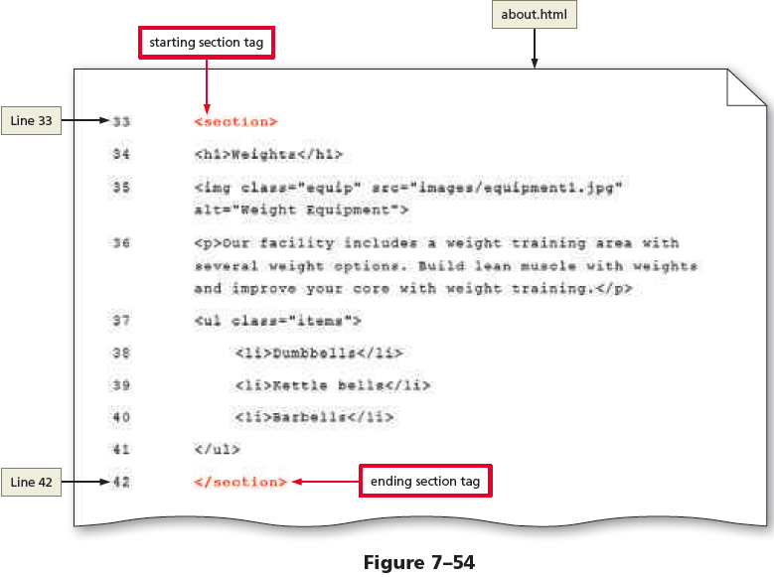
To Add Section Elements to the About Us Page

Slide 26
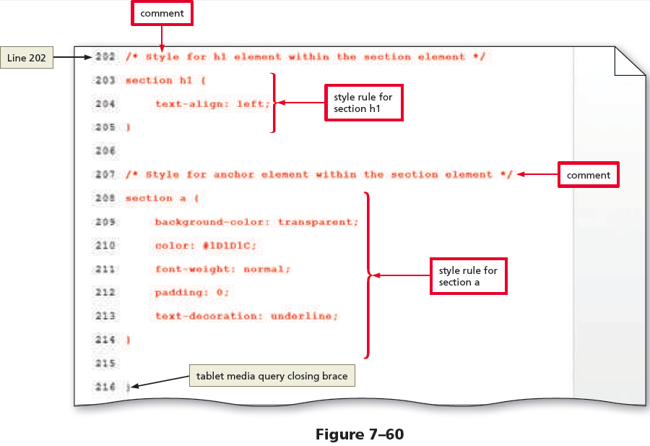
To Style the About Us Page for a Tablet Viewport

Slide 27
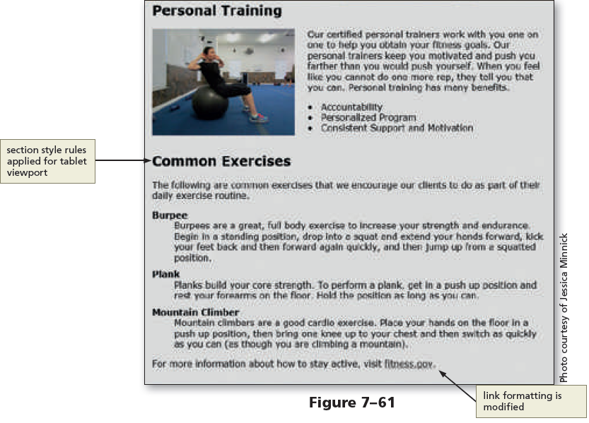
To Style the About Us Page for a Tablet Viewport (continued)

Slide 28
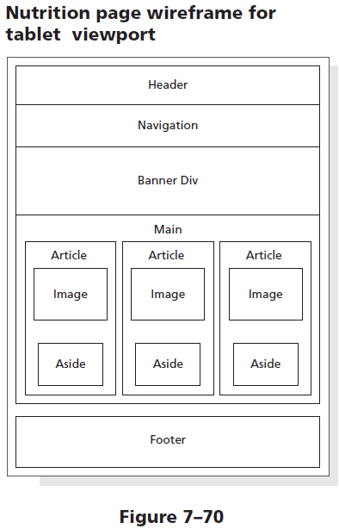
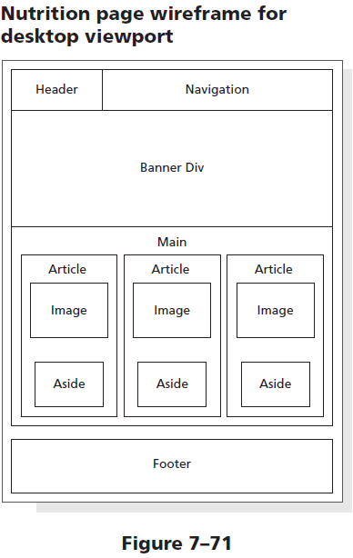
Creating the Nutrition Page

Slide 29
Creating the Nutrition Page (continued)
Overflow property – It is used to specify how to manage content when it “spills over” into another element

Slide 30
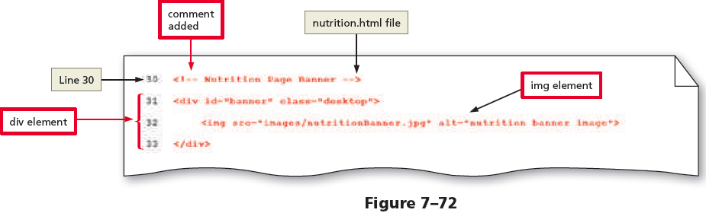
To Create the Nutrition Page

Slide 31
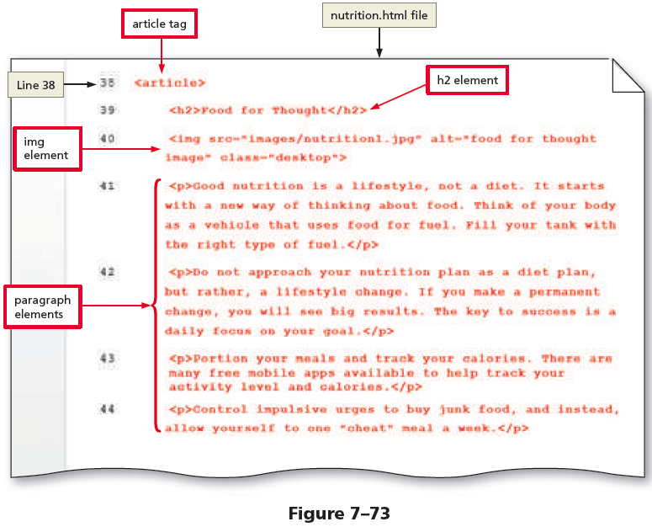
To Add article and aside Elements to the Nutrition Page

Slide 32
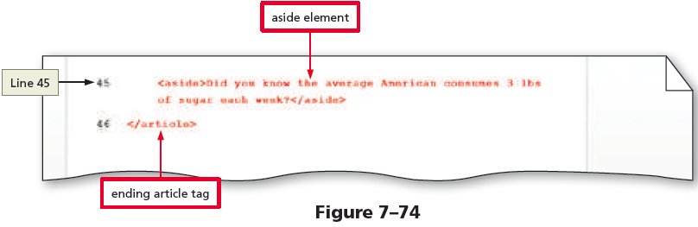
To Add article and aside Elements to the Nutrition Page (continued 1)

Slide 33
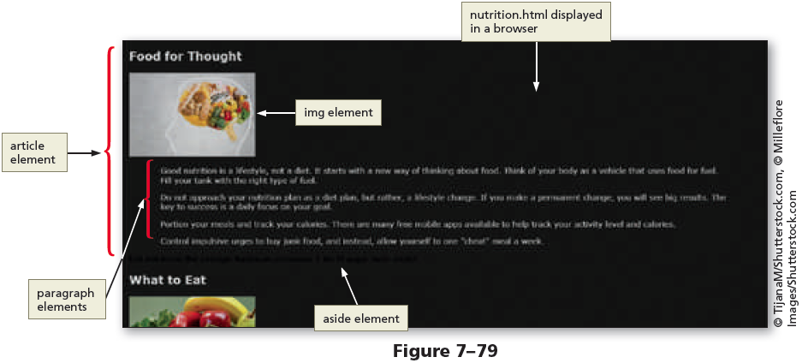
To Add article and aside Elements to the Nutrition Page (continued 2)

Slide 34
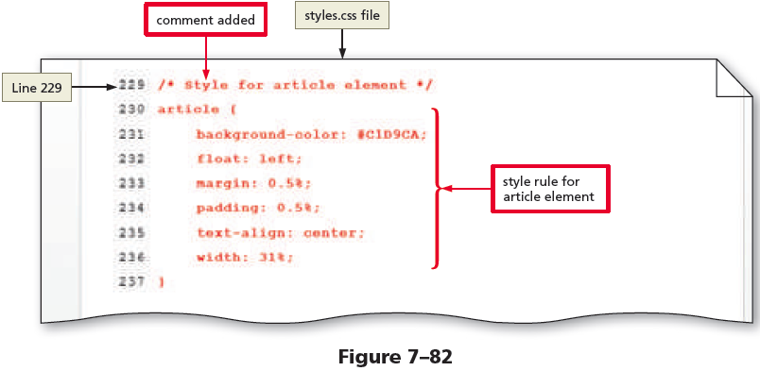
To Create a Three-Column Layout for the Nutrition Page in a Tablet Viewport

Slide 35
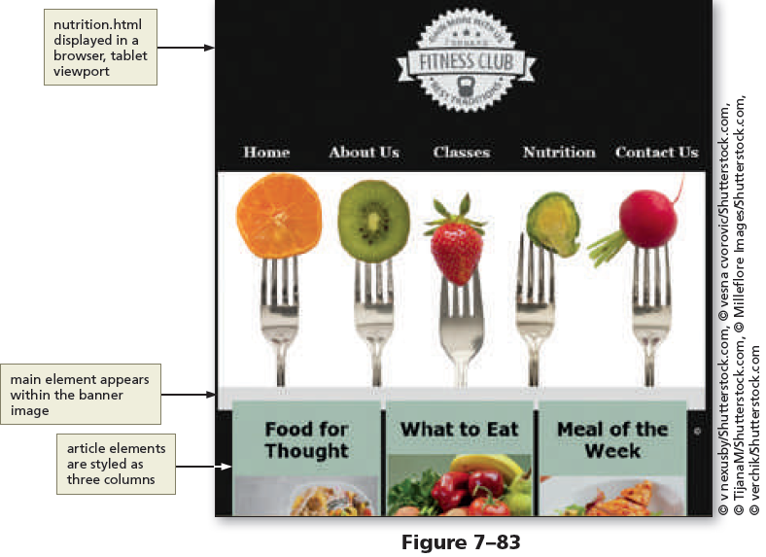
To Create a Three-Column Layout for the Nutrition Page in a Tablet Viewport (continued)

Slide 36
To Apply the Overflow Property to the main Element Style Rule
The main element is not in the correct area in Figure 7–83
The float property used within the article style rule displaces the main element to the banner image area
To correct this issue, apply an overflow property with a value of auto to the main style rule contained within the tablet media query
Use overflow: auto; to add a property and value

Slide 37
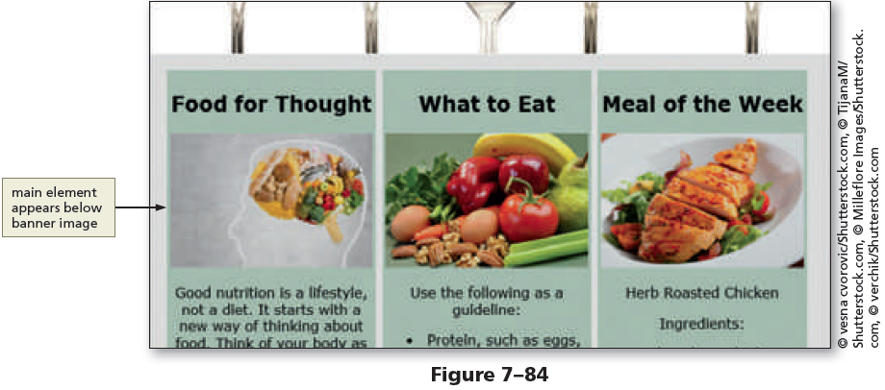
To Apply the Overflow Property to the main Element Style Rule (continued)

Slide 38
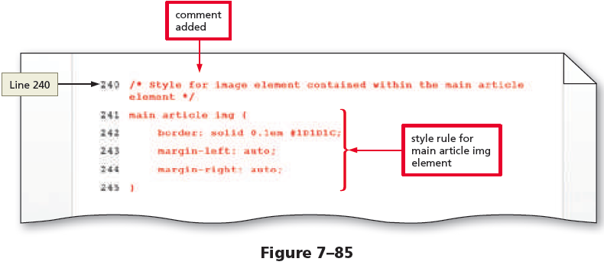
To Style the article Element for the Nutrition Page

Slide 39
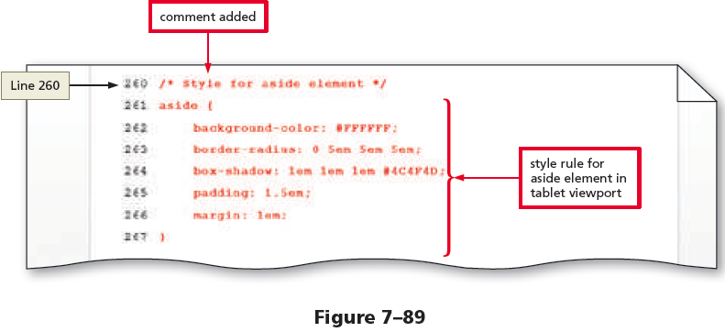
To Style the aside Element for the Nutrition Page

Slide 40
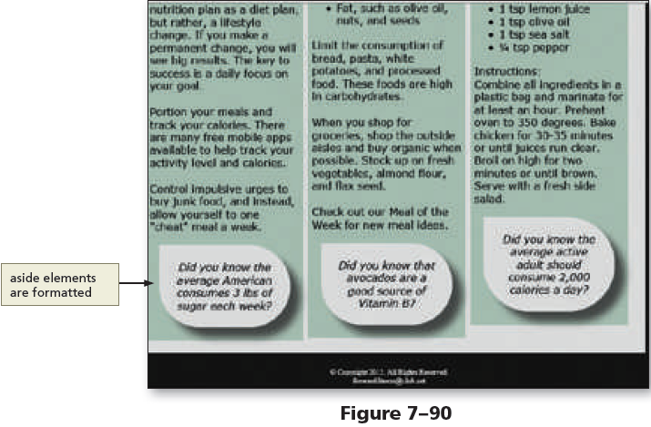
To Style the aside Element for the Nutrition Page (continued)

Slide 41
HTML5 & CSS3 8th Edition
Chapter 7 Complete

